Slide 1
The HCCH: Its Mandate, Main Achievements and Relevance for the Region
Georgetown, Guyana
July 2016
Christophe Bernasconi
Secretary General

Slide 2
What is the HCCH?
An intergovernmental organisation; origin goes back to 1893; working toward “progressive unification of the rules of private international law” (Art. 1 of the Statute)
Has a legislative function (i.e. is not a court or tribunal) – the only international organisation in The Hague with such a mandate)
Fulfils its mandate by developing and adopting Hague Conventions (as well as Protocols and more recently also a first soft law instrument), which have been referred to as “World laws” (Prof. Schermers, 1972)

Slide 3
What is the HCCH?
There are currently 38 Conventions and Protocols, as well as 1 soft law instrument, dealing with:
International Civil Procedure & Legal Co-operation
International Family Law & Child Protection
Commercial Law & Finance Law
Very practical outcome, which directly benefits people (adults, children, commercial operators and investors)

Slide 4
Resulting Benefits
of Hague Conventions
Facilitating international trade, commerce and foreign direct investment
Giving effect to
human rights
For example, the Apostille, Service of Process, Taking of Evidence, Access to Justice, Choice of Court, and Securities Conventions, as well as the Hague Principles provide legal certainty and predictability and establish uniform global standards, leading to a climate more conducive to cross-border trade and investment; some of these Conventions also greatly enhance administrative and judicial co-operation between States
For example, the Child Abduction, Child Protection, Adoption, and Child Support Conventions give effect to fundamental principles expounded in the 1989 UN Convention on the Rights of the Child (see also Hague Adults Convention which furthers some of the goals of the 2006 UN Convention on the Rights of Persons with Disabilities)

Slide 5
An evolving landscape: Two Main Activities of the HCCH
Normative Work
Post-Convention Work
Promotion
(of HCCH / its instruments)
Monitoring (Special Commissions on practical operation)
Publications
(Guides to Good Practice, Handbooks, etc.)
Technical Assistance
(implementation & practical operation)
Research
(identifying legal needs in other areas within mandate)
Proposals
(of new instruments)
Experts Discussion & Negotiation
(drafting process leading to
new legislative instruments: Conventions, Protocols, soft law)
AND

Slide 6
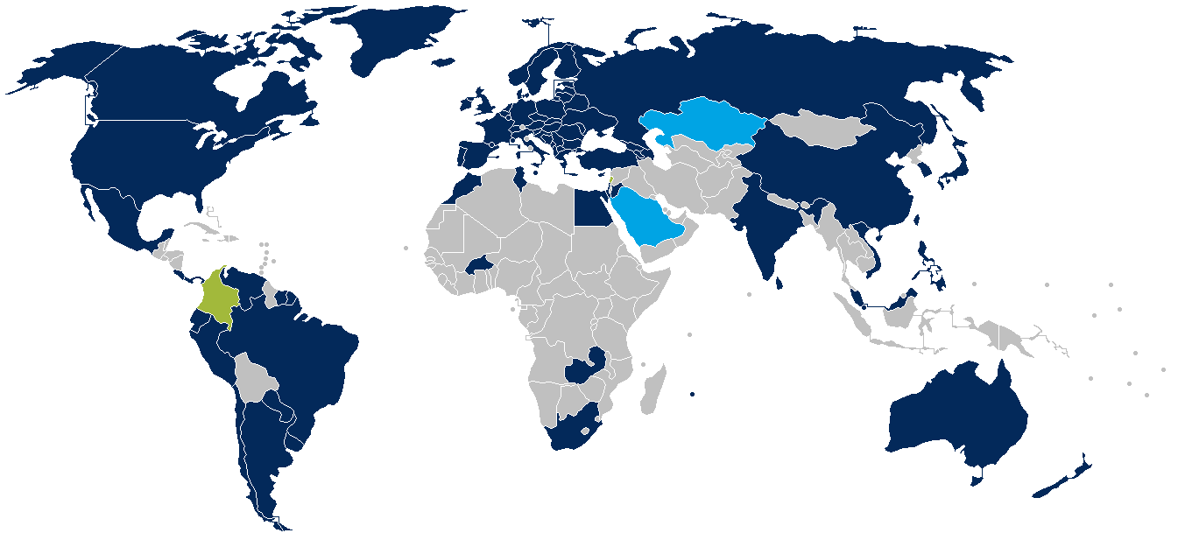
81 Members of HCCH
80 States + 1 Regional Economic Integration Organisation (EU)
■ Candidate State
Applied for membership
(six-month voting period)
Admitted State
Applied for membership,
admitted by affirmative vote,
must still accept Statute
■ Member State
NB: Boundaries on this map are based upon those used by the UN Cartographic Section. The number of States reflects the Parties as recorded by the Depositary (NL MFA). Neither should be taken to imply official endorsement or acceptance.

Slide 7
Membership Growth
34 New Members since 2000:
(42% of the Membership)
11 in Asia
11 in Europe
5 in Africa
4 in South America
2 in North America
1 in Oceania

Slide 8
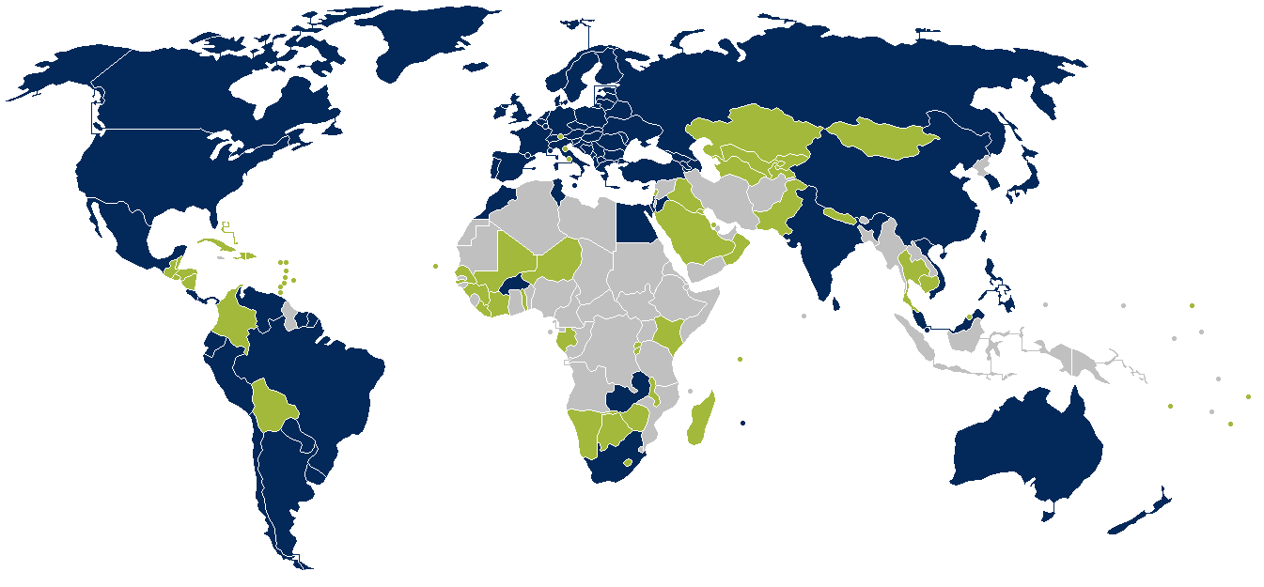
148 States “Connected” with HCCH
A “Connected” State is either a Member State (incl. candidate and admitted States), or a Contracting State to one or more of the Hague Conventions
■ Member State “Connected” State
■ Non-Member “Connected” State
NB: Boundaries on this map are based upon those used by the UN Cartographic Section. The number of States reflects the Parties as recorded by the Depositary (NL MFA). Neither should be taken to imply official endorsement or acceptance.

Slide 9
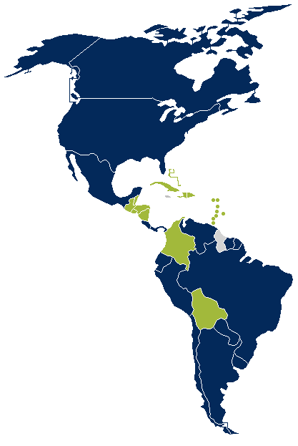
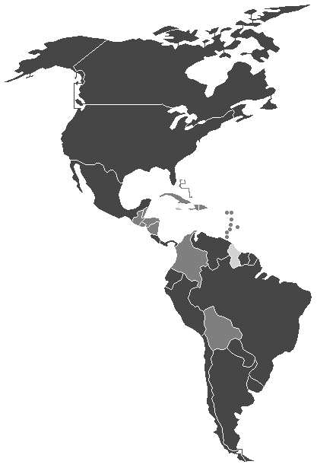
The HCCH in the Region
9 HCCH Member States
18
Other “Connected” States
NB: Boundaries on this map are based upon those used by the UN Cartographic Section. The number of States reflects the Parties as recorded by the Depositary (NL MFA). Neither should be taken to imply official endorsement or acceptance.
Notes:
*Note that only Sovereign States with separate international legal personality are shown on our maps* (e.g. not Puerto Rico, Curaçao, Guadeloupe, British Virgin Islands, etc.)
Antigua and Barbuda (Non-Member)
Apostille, Service
Bahamas (Non-Member)
Apostille, Service, Child Abduction
Barbados (Non-Member)
Apostille, Service, Evidence
Belize (Non-Member)
Apostille, Service, Child Abduction, Intercountry Adoption
Brazil (Member)
Apostille, Evidence, Child Abduction, Access to Justice, Intercountry Adoption
Colombia (Accepted State)
Apostille, Service, Evidence, Child Abduction, Intercountry Adoption
Costa Rica (Member)
Apostille, Service, Evidence, Child Abduction, Access to Justice, Intercountry Adoption
Cuba (Non-Member)
Intercountry Adoption
Dominica (Non-Member)
Apostille
Dominican Republic (Non-Member)
Apostille, Child Abduction, Intercountry Adoption, Child Protection
Ecuador (Member)
Apostille, Child Abduction, Intercountry Adoption, Child Protection
El Salvador (Non-Member)
Apostille, Child Abduction, Intercountry Adoption
Grenada (Non-Member)
Apostille
Guatemala (Non-Member)
Child Abduction, Intercountry Adoption
Guyana (Non-Member, Non-Connected)
Haiti (Non-Member)
Intercountry Adoption
Honduras (Non-Member)
Apostille, Child Abduction
Jamaica (Non-Member, Non-Connected)
Nicaragua (Non-Member)
Apostille, Child Abduction
Mexico (Member)
Apostille, Service, Evidence, Child Abduction, Intercountry Adoption, Choice of Court
Panama (Member)
Apostille, Child Abduction, Intercountry Adoption
Peru (Member)
Apostille, Child Abduction, Intercountry Adoption
Saint Kitts and Nevis (Non-Member)
Apostille, Child Abduction
Saint Lucia (Non-Member)
Apostille
Saint Vincent and the Grenadines (Non-Member)
Apostille, Service
Suriname (Member)
Civil Procedure, 1958 Maintenance, Apostille
Trinidad and Tobago (Non-Member)
Apostille, Child Abduction
USA (Member)
Apostille, Service, Evidence, Child Abduction, Intercountry Adoption
+ has signed: Trusts, Child Protection, Securities, Choice of Court, Maintenance
Venezuela (Member)
Apostille, Service, Evidence, Child Abduction, Intercountry Adoption

Slide 10
Regional Presence of the HCCH
Latin America Regional Office
Buenos Aires
(2005)
Asia Pacific
Regional Office
Hong Kong
(2012)
Main Office
The Hague
NB: Boundaries on this map are based upon those used by the UN Cartographic Section. The number of States reflects the Parties as recorded by the Depositary (NL MFA). Neither should be taken to imply official endorsement or acceptance.

Slide 11
Number of States/REIOs bound by the Core HCCH Conventions
Apostille
112
Intercountry Adoption
96
Child Abduction
94
Service
71
Evidence
59
Child Protection
44
Maintenance
32+1
Choice of Court
29+1

Slide 12
Why “HCCH”…?
Hague Conference on Private International Law
Conférence de La Haye de Droit International Privé

Slide 13
Why “HCCH”…?
Hague Conference on Private International Law
Conférence de La Haye de Droit International Privé

Slide 14
Thank you
Dr Christophe Bernasconi Secretary General
www.hcch.net

