Slide 1
iSupport

Slide 2
Sandbox – Using Internet Explorer (version 8 or above) or Chrome (42 or above)
iSupport - http://209.12.95.52/iSupportWeb

Slide 3
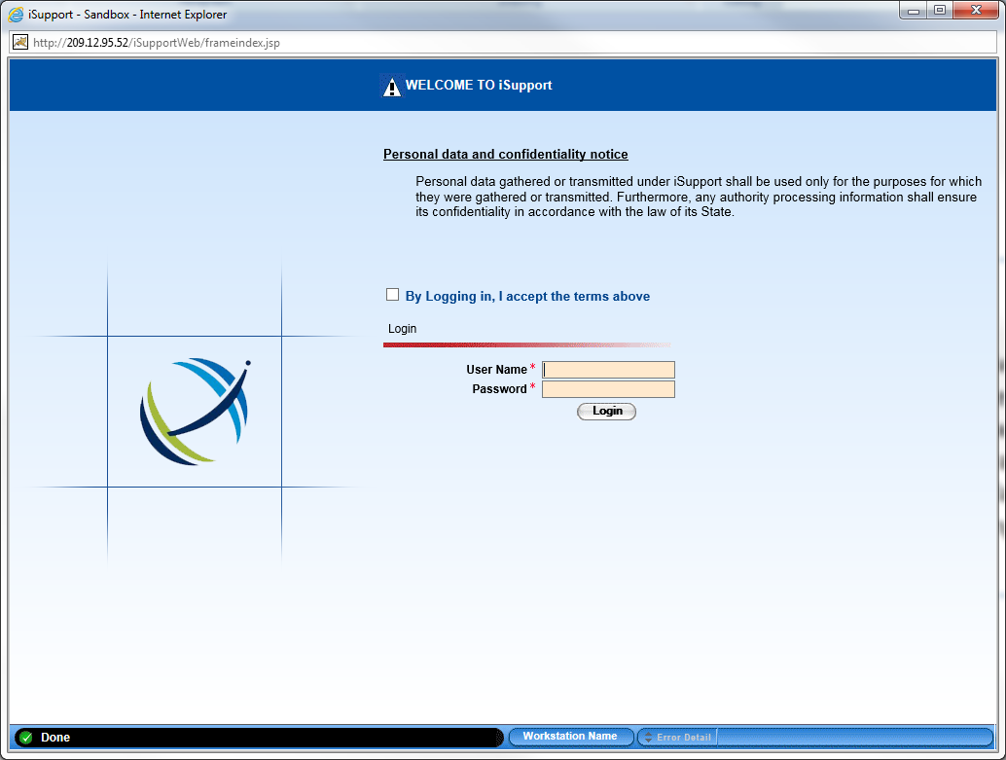
Logging into iSupport Sandbox http://209.12.95.52/iSupportWeb/applauncher.jsp
User Name
Password
Login Screen for iSupport Web

Slide 4
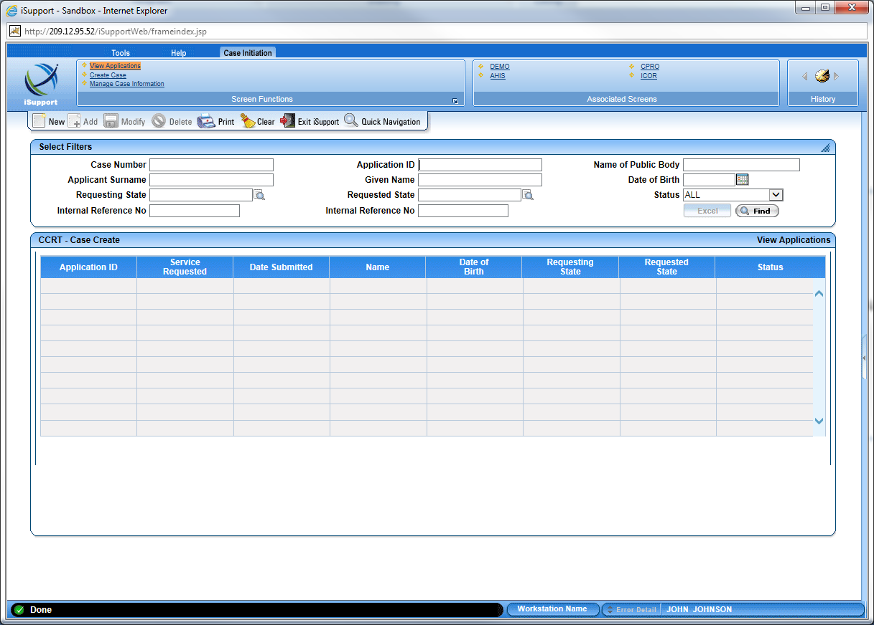
CCRT – Case Create
Create and search for cases using the CCRT screen

Slide 5
Documenting Errors
When errors occur, please log in Jira and describe the steps that you completed prior to the receiving of the error in a word document.
Identify the Case ID and screen
If applicable, insert before and after screen shots in a comment to your Issue
<copy screen> Alt + Print Screen
<paste screen> Ctrl + V
The word document is available in Jira.

Slide 6
Sandbox Questions or Issues
iSupport@hcch.nl
Francis.Powell@ProtechSolutions.com
501-687-2327
MMckinney@Protechsolutions.com
501-687-2314

