Slide 1
The 2015 Principles on Choice of Law in International Commercial Contracts:
Impact and Questions

Slide 2
The 2015 Principles, the first “soft-law” instrument of the HCCH, are designed to promote party autonomy in international commercial contracts.
2

Slide 3
While strengthening the concept of party autonomy, the 2015 Principles also set well-defined boundaries, thus refining and balancing the concept.
3

Slide 4
The 2015 Principles provide a comprehensive blueprint for users to create, reform, or interpret choice of law regimes at the national, regional, or international levels.
4

Slide 5
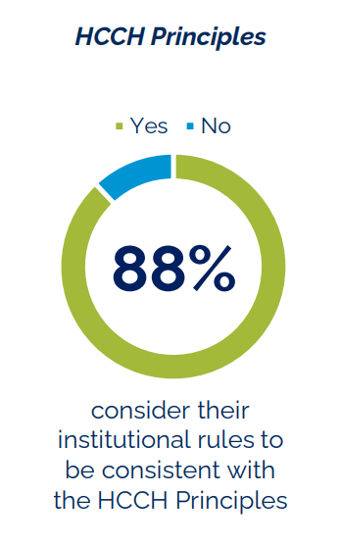
The 2015 Principles have served as both inspiration and a model for the development of national or regional laws on international commercial contracts.
Findings from 2022 HCCH survey of 25 arbitration centres
5

Slide 6
They have been endorsed by international organisations that aim at harmonising law or promoting cross-border business, such as UNCITRAL, the International Chamber of Commerce, and the Inter-American Juridical Committee of the OAS.
6

Slide 7
Here are some questions about the 2015 Principles that will be addressed at CODIFI.
7

Slide 8
How is the choice of law negotiated in international commercial contracts, and what are practical impacts of this choice?
8

Slide 9
To what extent will parties’ choice of law be respected?
What are possible limitations, and how do they differ between litigation and arbitration?
9

Slide 10
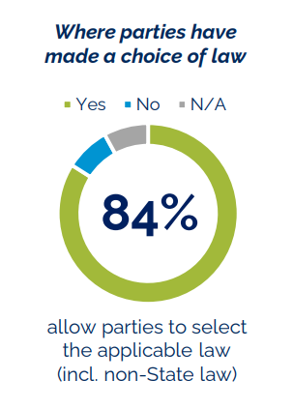
Will parties’ choice of non-State law be accepted?
How do practices differ between litigation and arbitration?
Findings from 2022 HCCH survey of 25 arbitration centres
10

Slide 11
What is the need for harmonisation of choice of law rules in international commercial contracts?
11

Slide 12
Would you like to know more? See Preliminary Document 9 (CGAP 2022) of the HCCH.
Join us at CODIFI!
Online, 12-16 September 2022

